Slide 1

Chapter no. 6 (Write)

Slide 2

Group Members
Omar Baig (2024-GenAI-09)
Shahbaz Ali (2024-GenAI-07)
M. Nouman (2024-GenAI-08)
M. Faizan (2024-GenAI-)
Afzal Hussain (2024-GenAI-41)
Khuram Iqbal (2024-GenAI-43)

Slide 3

Introduction to Generative Models for Text Data
Overview of generative models for text data
Importance of understanding differences between text and image data

Slide 4

Key Differences Between Text and Image Data
Discrete vs. Continuous Data
Text: Discrete units
Challenge: Applying backpropagation to text
Temporal vs. Spatial Dimensions
Text: Time dimension, word order matters
Challenge: Capturing sequential dependencies
Sensitivity to Small Changes
Text: Highly sensitive, changes affect coherence
Images: Less sensitive to pixel changes
Challenge: Maintaining coherence in text generation

Slide 5

Key Differences Between Text and Image Data
Grammatical and Semantic Rules
Text: Strict grammatical and semantic rules
Images: No strict rules for pixel values
Challenge: Ensuring grammatical and semantic correctness

Slide 6

The Literary Society for Troublesome Miscreants
Concept: Edward Sopp, a prison warden, uses inmates to generate stories
Outcome: Proficiency in generating realistic text

Slide 7

Recurrent Neural Networks
Structure: Recurrent layer allows past information to influence current predictions
Limitation: Simple tanh operator led to vanishing gradient problem

Slide 8

Introduction to LSTM Networks
Definition: a type of RNNs Recurrent Neural Network that can detain long-term dependencies in sequential data
Function: Incorporates past information into current predictions
Evolution: Overcame vanishing gradient problem in early RNNs
Adaptations: Variations like GRUs developed

Slide 9

Text Tokenization and LSTM Training for Word Prediction

Slide 10
Introduction to Tokenization
Definition: Tokenization is the process of splitting text into individual units
Importance: Choice of tokenization affects text cleaning, model training, and output

Slide 11

Word Tokenization Overview
Lowercasing: Convert all text to lowercase
Vocabulary Size: Large vocabulary due to distinct words
Sparse Words: Replace infrequent words with an "unknown" token
Example
Original: "I love New York City."
Tokenized: "I, love, New, York, City, ."

Slide 12
Word Tokenization Considerations
Stemming: Reducing words to their root form
Example: "browsing", "browsed", "browses" -> "brows"
Punctuation Handling: Tokenize or remove punctuation
Vocabulary Limitation: Model cannot predict words outside training vocabulary

Slide 13

Character Tokenization Overview
Flexibility: Can generate new words outside training vocabulary
Vocabulary Size: Much smaller
Case Sensitivity: Decide whether to convert capital letters to lowercase

Slide 14
LSTM Architecture Overview

Slide 15
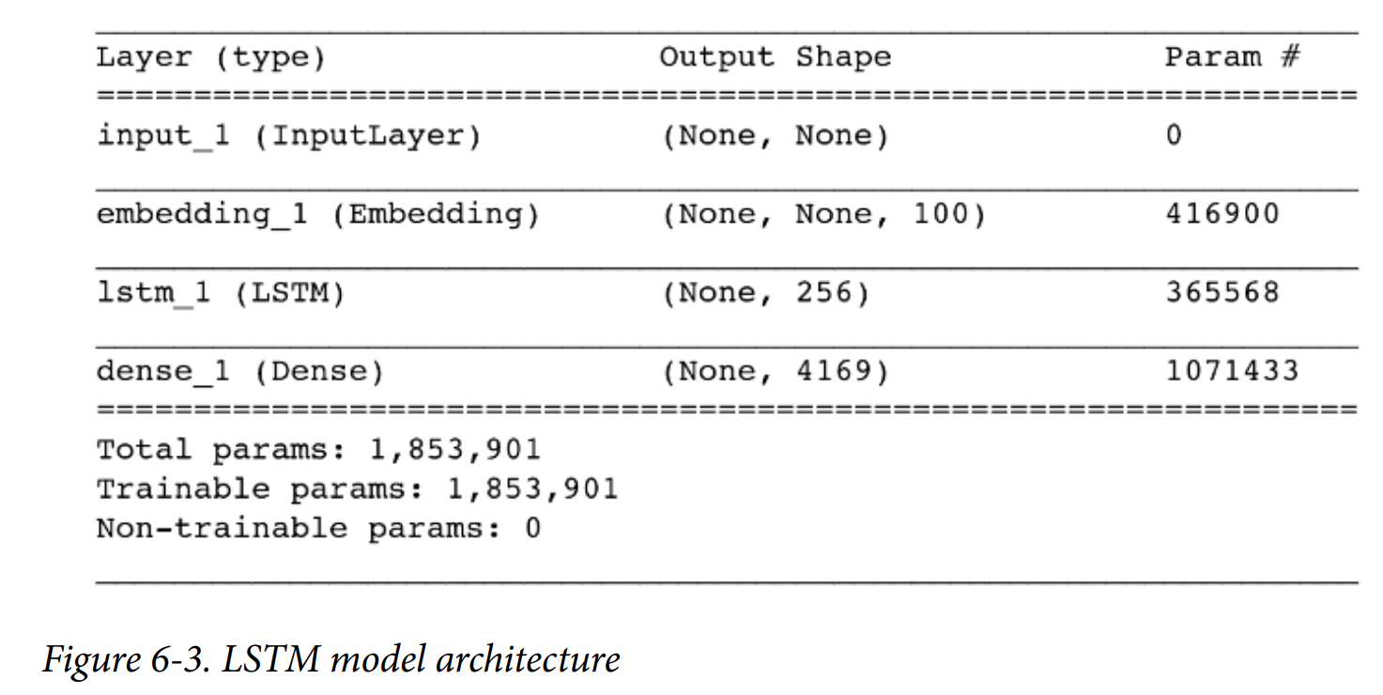
Overview
Input: Sequence of integer tokens
Output: Probability of each word in the vocabulary appearing next
Key Components: Embedding Layer, LSTM Layer

Slide 16
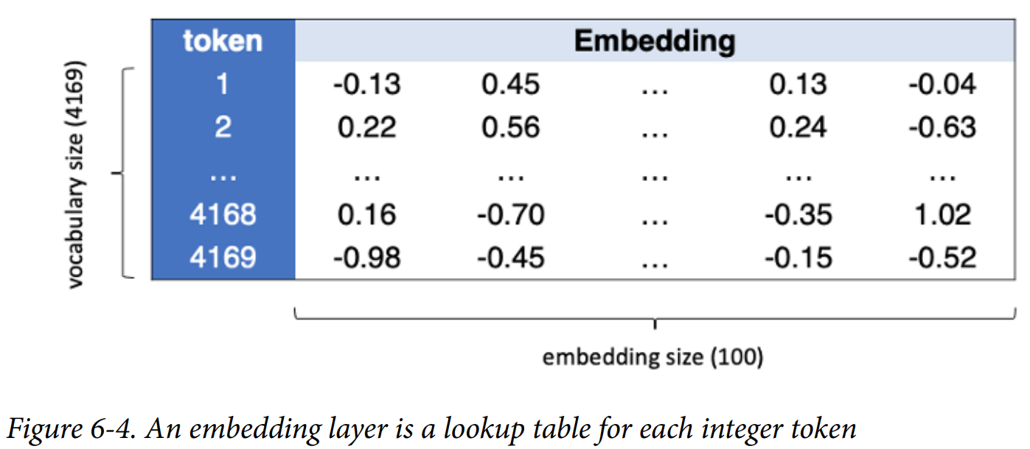
The Embedding Layer
Converts each token into a vector of length embedding_size

Slide 17
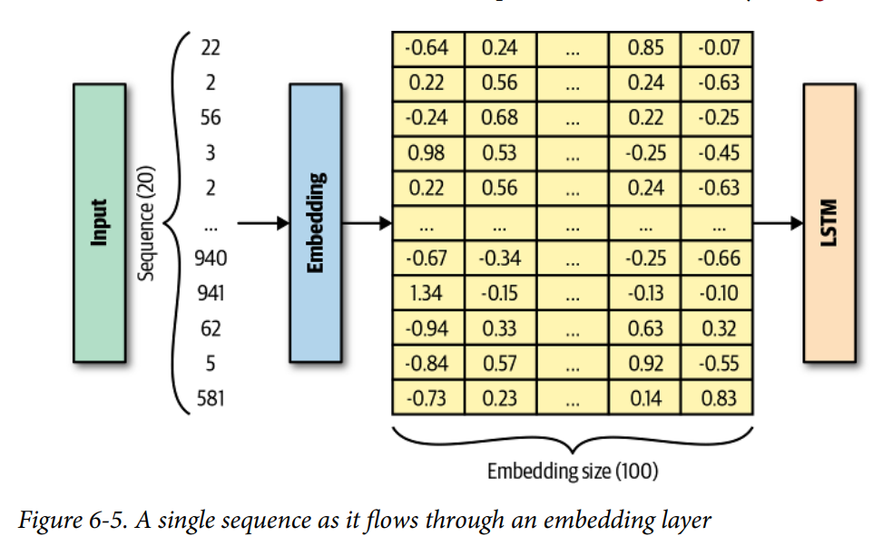
Weights
Number of weights = Size of vocabulary * embedding_size
Tensors
Input: [batch_size, seq_length]
Output: [batch_size, seq_length, embedding_size]

Slide 18
LSTM Layer

Slide 19
Introduction to Recurrent Layers
Understanding Recurrent Layers:
Processes sequential input data [x1,...,xn].
Uses a cell that updates its hidden state h(t) with each sequence element x(t) .
Hidden State in Recurrent Layers:
The hidden state h(t) is a vector reflecting the cell’s understanding of the sequence.
At timestep t, the cell updates h(t) using h(t-1) and x(t) .
Sequential Processing:
The cell processes each sequence element one timestep at a time.
After processing the sequence, the final hidden state h(n) is passed to the next network layer.

Slide 20
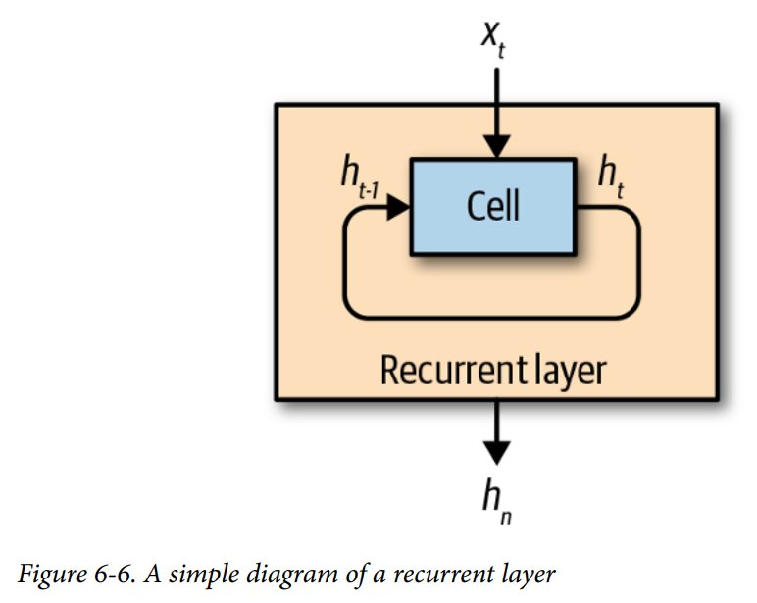
Visualization of Recurrent Layers:

Slide 21
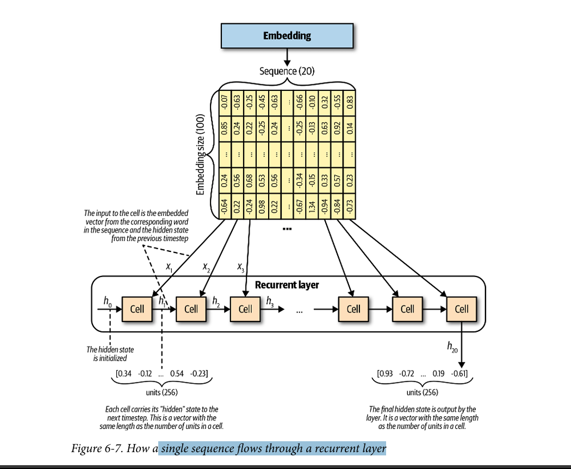
Single Sequence Flow Through a Recurrent Layer

Slide 22
Introduction to LSTM Cells
Role of LSTM Cells:
Outputs a new hidden state h(t) based on the previous hidden state h(t-1) and current word embedding x(t).
Cell State in LSTM Cells:
Maintains a cell state C(t) representing the cell’s internal status of the sequence.
The cell state and hidden state are both vectors with lengths equal to the number of units in the cell.
Difference Between Cell and Unit:
One LSTM cell contains multiple units.
The number of units is set during the layer definition and is unrelated to sequence length.

Slide 23
Detailed Functioning of an LSTM Cell
Step-by-Step Process in an LSTM Cell:
Step 1: Forget Gate
Concatenates h(t-1) and x(t) , passes through the forget gate.
The forget gate is a dense layer with weights W(f) , bias b(f), and a sigmoid activation.
Produces f(t) , determining how much of the previous cell state C(t-1) to retain.
Step 2: Input Gate
Concatenated vector passes through the input gate (dense layer with W(i), b(i) , sigmoid activation).
Produces I(t) , determining how much new information to add to C(t-1) .

Slide 24
Detailed Functioning of an LSTM Cell
Step 3: New Information Vector
Concatenated vector passes through a dense layer with W(c) , b(c), and tanh activation to generate C(~t) .
C(~t) contains the new information the cell considers keeping.
Step 4: Update Cell State
Element-wise multiplication of f(t) and C(t-1) is added to the element-wise multiplication of I(t) and C(~t) .
Produces the updated cell state C(t) .
Step 5: Output Gate
Concatenated vector passes through the output gate (dense layer with W(o) , b(o) , sigmoid activation).
Produces o(t) , determining how much of C(t) to output from the cell.
Step 6: New Hidden State
Element-wise multiplication of o(t) and tanh(Ct) produces the new hidden state h(t) .

Slide 25
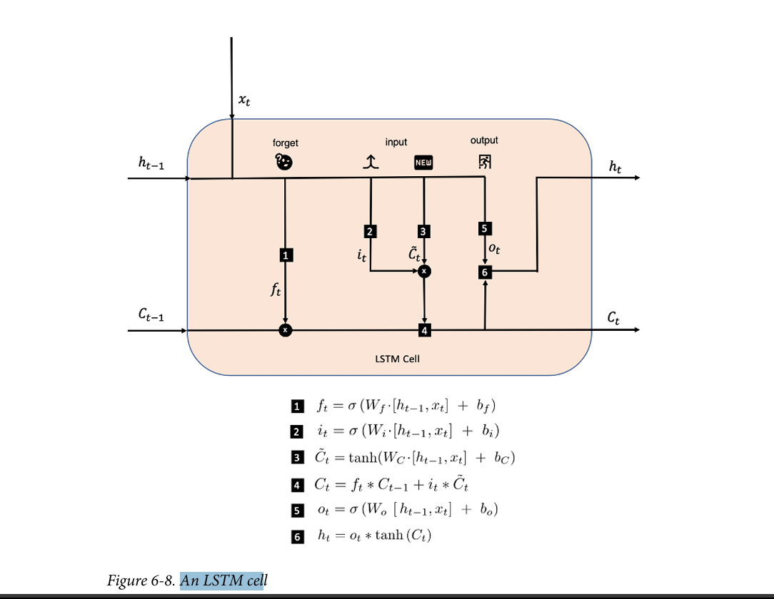
An LSTM Cell:

Slide 26

Generating Text with LSTM Networks

Slide 27

Process Overview
Text Generation Process
Content
Outline the step-by-step process for generating text
Feed the network with an initial sequence of words
Use the network to predict the next word
Append the predicted word to the sequence
Repeat the process to generate a longer string of text

Slide 28

Sampling with Temperature
Sampling with Temperature
Content
Explain the concept of sampling from the model's output probabilities
Introduce the temperature parameter
Low temperature More deterministic, less random choices
High temperature More random, diverse choices
Mention that temperature helps control the creativity and coherence of generated text

Slide 29
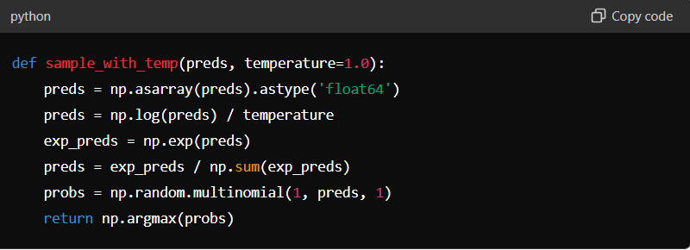
Example Code - Sampling Function

Slide 30
Text Generation Function
Text Generation Function
Steps involved
Convert the seed text to a sequence of tokens
Predict the next word using the model
Append the predicted word to the seed text
Repeat the process to generate the desired number of words

Slide 31
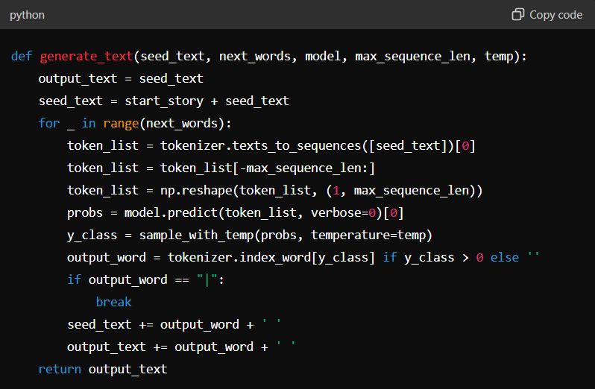

Slide 32
Temperature Impact
Impact of Temperature on Generation
Effect of temperature on text generation
Low Temperature Generates text that is less adventurous
but more coherent
High Temperature Generates text that is more diverse
but less coherent.

Slide 33
RNN Extensions

Slide 34
Introduction to RNN Extensions
Overview: Building on the basic LSTM network, RNN extensions enhance capabilities for more complex tasks.
Extensions Covered:
Stacked Recurrent Networks
Gated Recurrent Units (GRUs)
Bidirectional Cells
Encoder-Decoder Models

Slide 35
Stacked Recurrent Networks
Single LSTM layer can be extended to multiple layers.
Stacked LSTM layers learn deeper features from text.
Configuring Stacked Networks
return_sequences parameter set to True in the first LSTM layer.
Outputs hidden state from every timestep.
Second LSTM layer uses hidden states from the first layer.

Slide 36
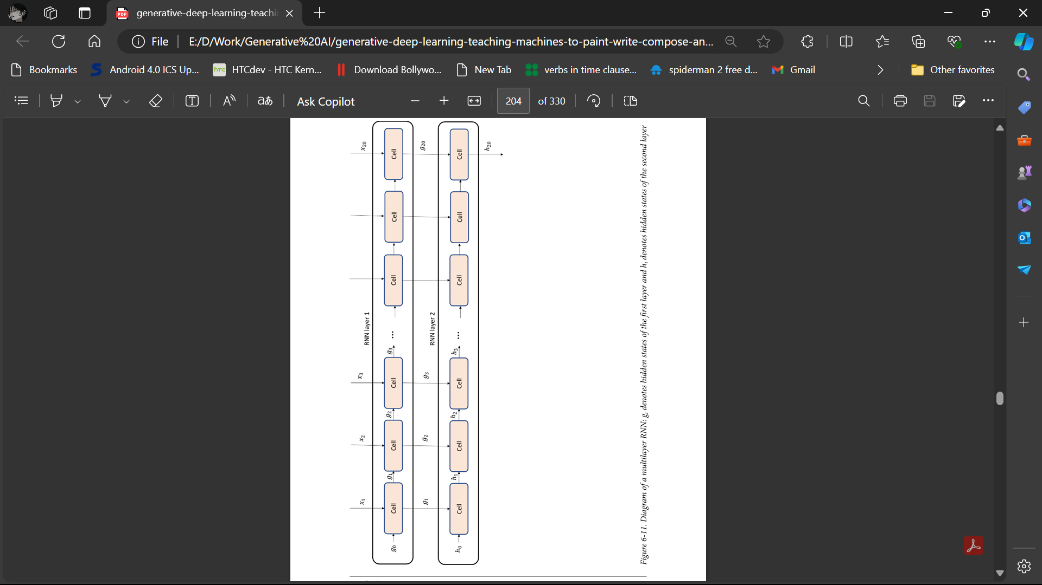
Diagram of a multilayer RNN.

Slide 37
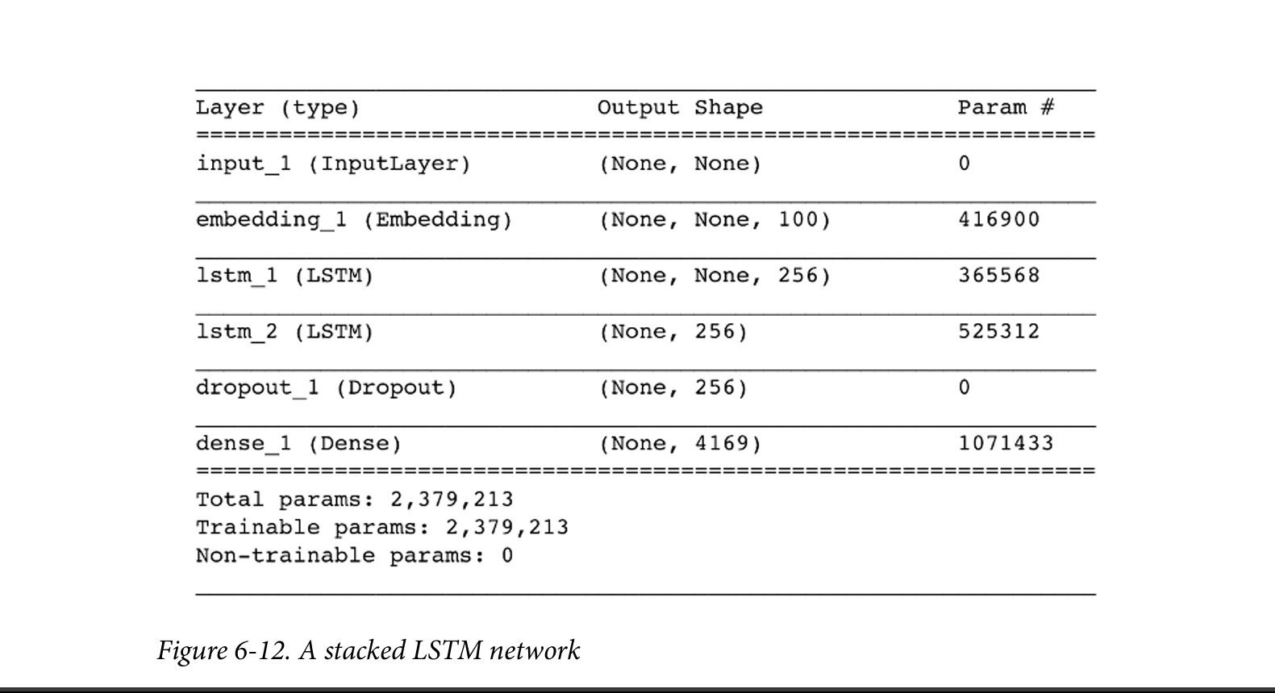
A stacked LSTM network.

Slide 38
Code Example for Stacked LSTM
text_in = Input(shape=(None,))
embedding = Embedding(total_words, embedding_size)
x = embedding(text_in)
x = LSTM(n_units, return_sequences=True)(x)
x = LSTM(n_units)(x)
x = Dropout(0.2)(x)
text_out = Dense(total_words, activation='softmax')(x)
model = Model(text_in, text_out)

Slide 39
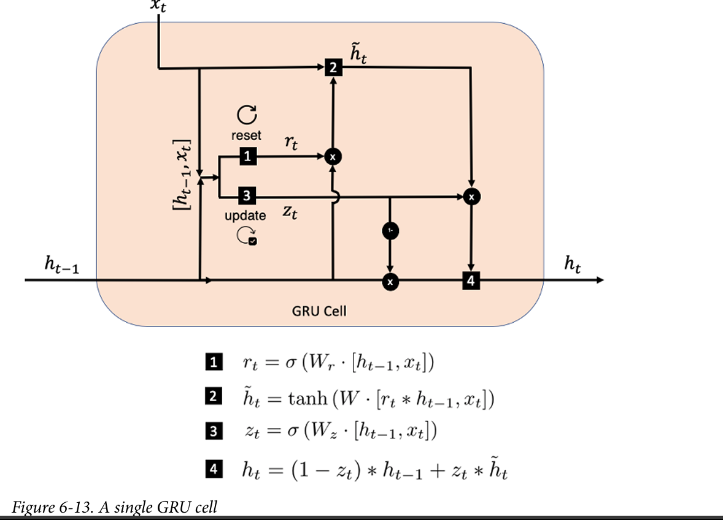
Gated Recurrent Units (GRU)
GRU: An alternative to LSTM.
Differences:
Forget and input gates are replaced by reset and update gates.
No cell state or output gate, only a hidden state.

Slide 40
GRU Cell Process
Previous hidden state h(t-1) and current word embedding x(t) create reset gate.
Reset gate applied to h(t-1) and x(t) to generate new beliefs vector h(~t) .
H(t-1) and x(t) also create the update gate.
New beliefs h(~t) and h(t-1) blended to produce updated hidden state h(t).

Slide 41
Bidirectional Cells
For tasks with entire text available at inference.
Processes sequence in both forward and backward directions.
Two sets of hidden states: forward and backward.
Implemented as a wrapper around a recurrent layer in Keras.
(PYTHON CODE):
"layer = Bidirectional(GRU(100))"
Hidden states are vectors of length double the number of units.

Slide 42
Encoder-Decoder Models
Used for tasks like language translation, question generation, and text summarization.
Processes:
Encoder summarizes input sequence into a vector.
Decoder uses this vector to initialize and generate output sequence.
Decoder's hidden state connected to dense layer for vocabulary distribution.

Slide 43
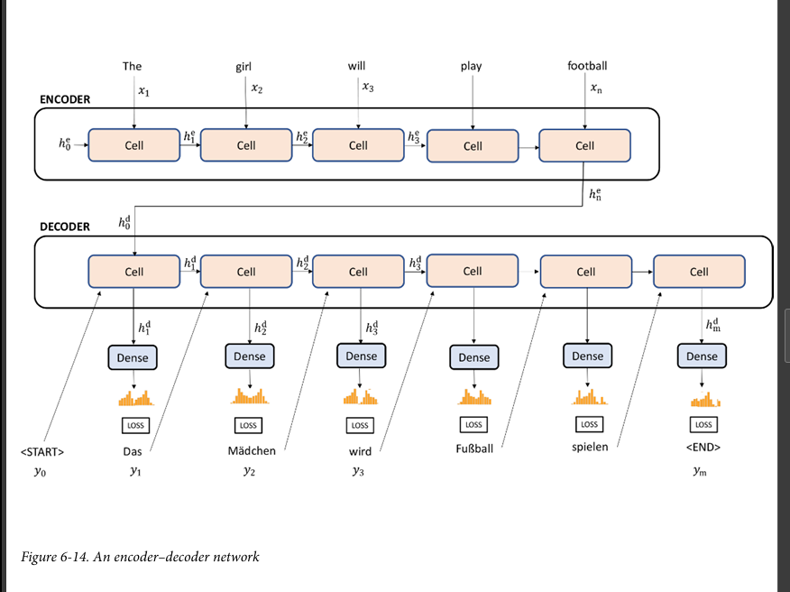
Encoder-Decoder Models

